Slide 1
KBYG & Coach Prep
Microsoft Azure Well-Architected Framework
[Event Start Date – Event End Date]
Tech Lead: [Name]
Project Lead: [Name]

Slide 2
Agenda
Overview
Coach Agenda
Optimizing for a Virtual Experience
Coach Resources
Opsgility Portal
Technical Skills Initiative (TSI)
Coaching Principles
Challenge Overview
Working Session
Q&A
Get Involved

Slide 3
Tech Lead and Project Lead
[Name] Tech Lead
[Name] Project Lead
Est No of Attendees: [#]
Current Reg: [#]
# of Coaches: [#]

Slide 4
Coach Agenda
update agenda accordingly
<date> | <date> | <date>
8:00 – 8:45 AM | Morning Standup 9:00 – 10:00 AM | Opening + Welcome 10:00 AM – 12:00 PM | Team Hacking 12:00 – 1:00 PM | Break 1:00 – 4:00 PM | Team Hacking 4:15 – 5:00 PM | Afternoon Standup | 8:00 – 8:45 AM | Morning Standup 9:00 – 9:30 AM | Morning Announcements 9:30 AM – 12:00 PM | Team Hacking 12:00 – 1:00 PM | Break 1:00 – 4:00 PM | Team Hacking 4:15 – 5:00 PM | Afternoon Standup | 8:00 – 8:45 AM | Morning Standup 9:00 – 9:30 AM | Morning Announcements 9:30 AM – 12:00 PM | Team Hacking 12:00 – 1:00 PM | Break 1:00 – 3:30 PM | Team Hacking 3:30 – 4:00 PM | Closing Remarks 4:15 – 5:00 PM | Afternoon Standup

Slide 5
Optimizing for a Virtual Experience
Each team will have their own channel for collaboration
Collaborate in Microsoft Teams and monitor the General / Coach channels for updates from the PM team
Keep your mic and video on to promote engagement and remind participants to do the same
Feedback is an important program driver, consider running retros after each challenge and add all feedback to the Opsgility portal
Reinforce working agreement
Take breaks as needed but suggest doing so as a team so no one is left behind
Notes:
Working agreement = breaks, standups, retros, alternate sharing screen on challenges

Slide 6
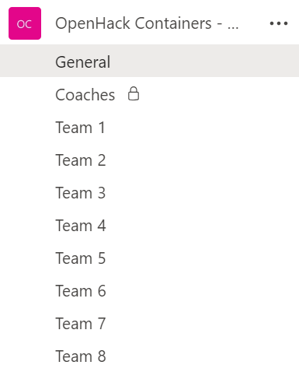
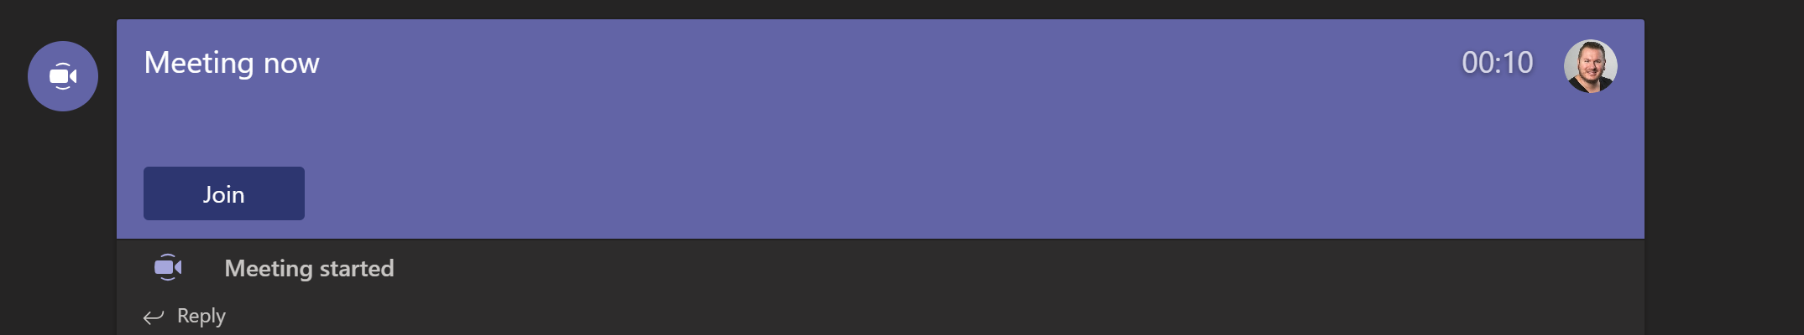
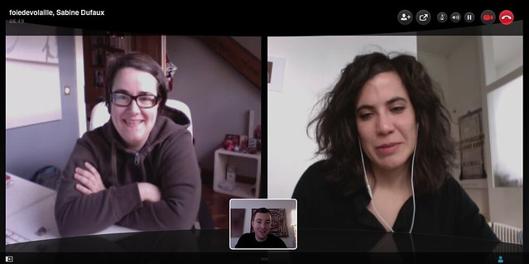
Collaborate
Step 1 (Move to Team channel)
Step 2 (Coach starts a meeting)
Step 3 (Join the meeting)
Your channel is your Team #
Step 4 (Turn on mic and video)
insert snip of actual teams channel
This Photo by Unknown Author is licensed under CC BY

Slide 7

Coach Resources
Coaches Guide will include resources such as:
Team assignments
Guidance on managing your team’s channel
Submitting feedback
Participant survey link
Opsgility portal coach guide
Other Coach-specific resources will be posted to Files under the Coaches channel

Slide 8
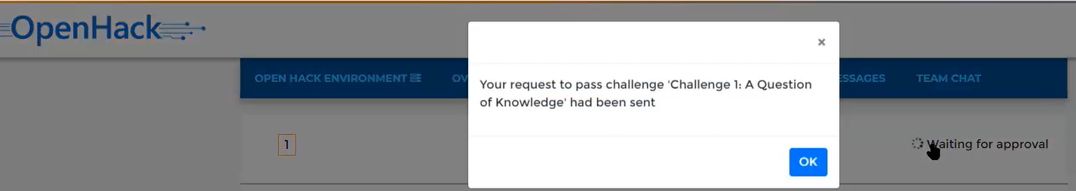
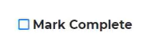
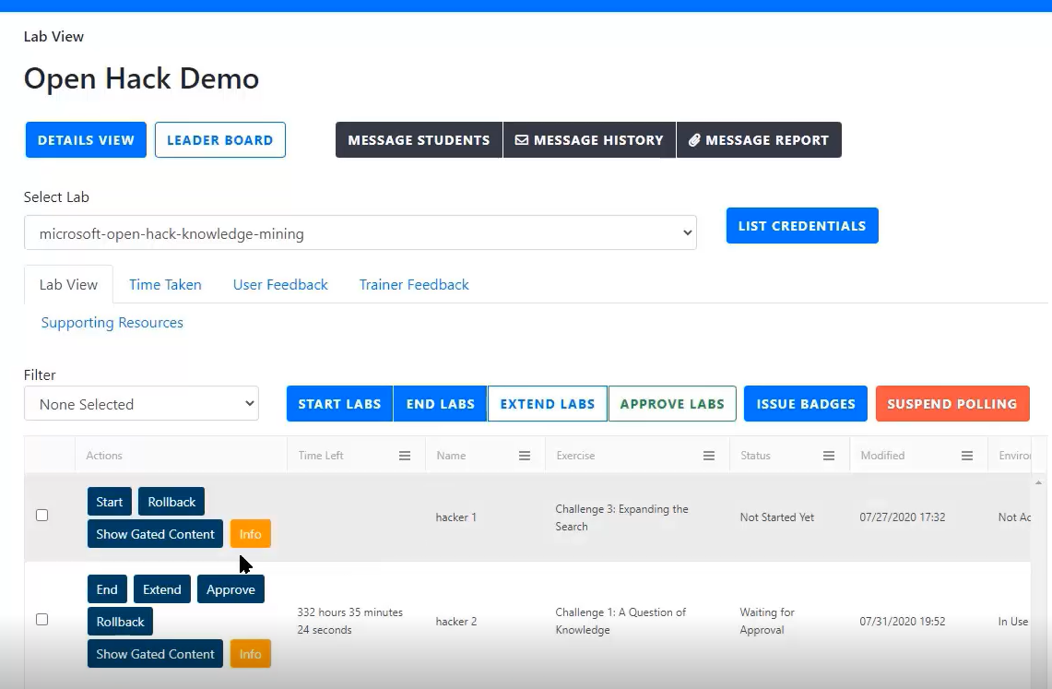
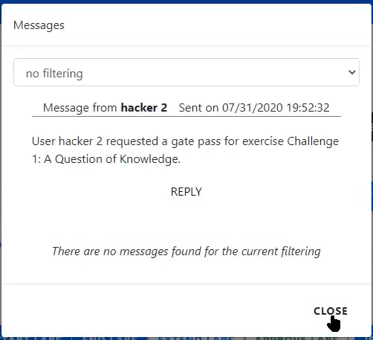
How to approve your team to next challenge
1. A team will indicate they have completed the Challenge in the attendee portal.
2. In the Lab View tab coaches will get pop-up notifications when a team has requested approval for the next challenge
3. By default all teams, available actions, and status will be listed. Find your team using the Name column. Select Approve once you validate your team’s progress.
Note: you can filter the messages from your team with the ‘Filter’ dropdown.

Slide 9
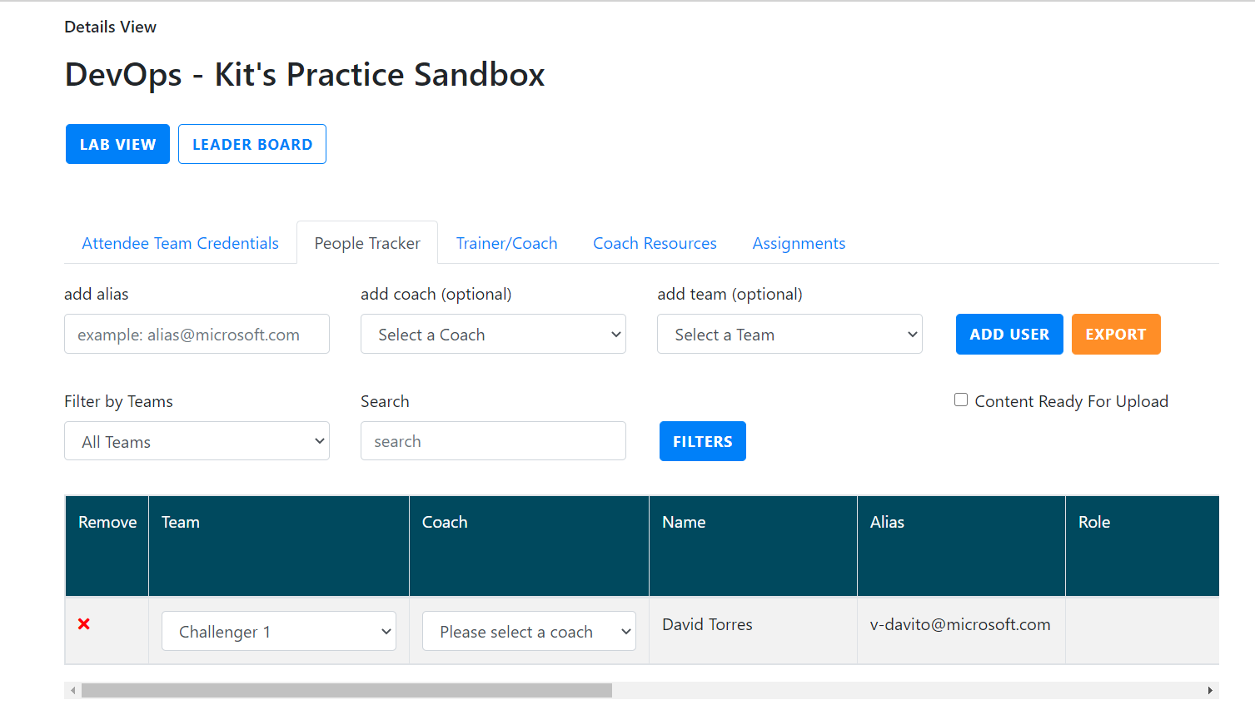
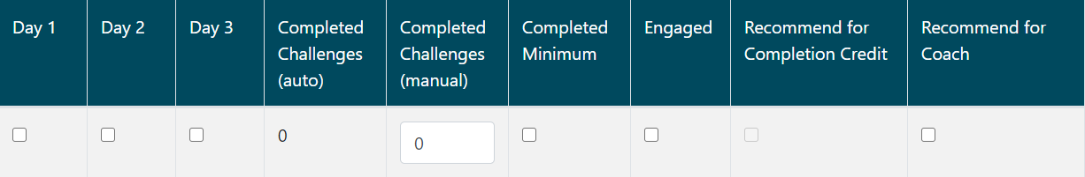
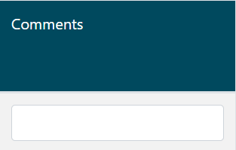
People tracker
3. Enter data for all fields in the people tracker. Note that all fields are necessary.
1. In the Details view tab use the People Tracker to capture all OpenHack TSI mandatory requirements.
2. First, add the Microsoft alias of the attendees on your team to using the Add User button. Select your team number and yourself as a coach for EACH user added.
Team | Assign the correct team number to attendee
Coach | Add the respective coach assigned to attendee
Name | Auto populated based on alias entry
Alias | Auto populated based on alias entry
Days | Validate attendance EVERY DAY of the OpenHack
Complete Challenges (auto) | Auto filled based progress in attendee portal
Completed Challenges (manual) | Requires coaches to manually add the actual challenge complete as this may not be uniform for all team members in case some teammates leave early
Engaged | Check if attendee was engaged
Recommended for Completion Credit | IMPT! Auto populated base on all other fields being completed. This is what determines TSI recommendation
Recommended for Coach | Check IF attendee is recommended to be a future coach.
Comments | A comment is required if a person is NOT being recommended for TSI completion.

Slide 10
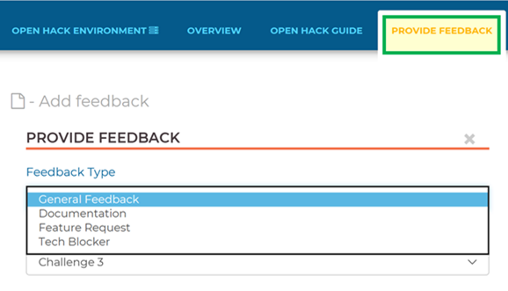
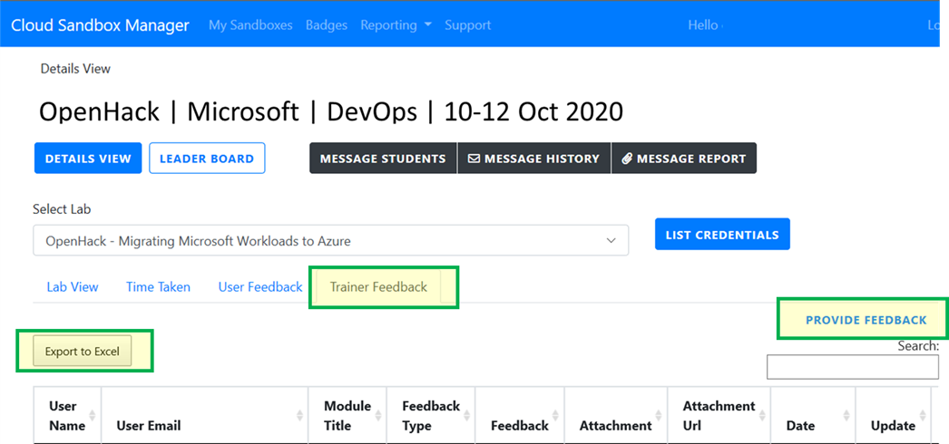
Submitting Feedback
Participant feedback is captured in the final attendee classroom environment in the 'Provide Feedback’ tab.
Coach feedback is captured in the OpenHack classroom admin portal in the Lab view tab 'Trainer Feedback'.

Slide 11
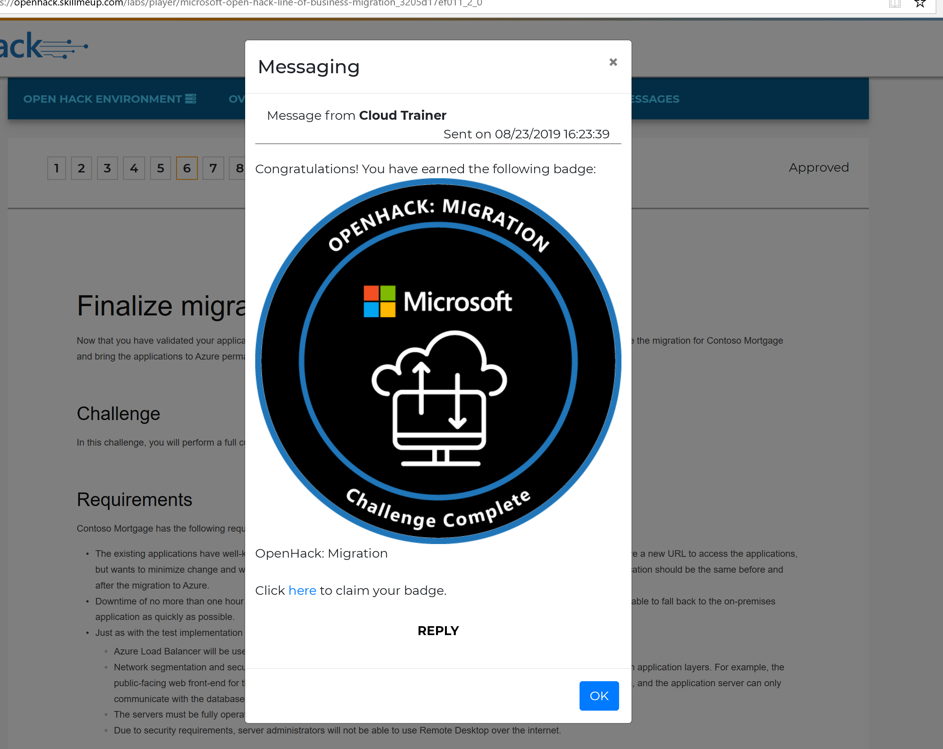
Issuing badges
Attendee badges are awarded automatically.
The badge is awarded upon completion of a challenge level that implies the attendee has sufficient understanding of the OH material.
When the coach approves the correlating challenge level as completed the attendee will receive a pop-up in their portal alerting them to claim their badge.
If users see an error when trying to claim their badge, the most common reason is that users need to log in again with their team’s skillmeup credential before they can input their personal acclaim details.
Coach, Tech Lead, and Project Lead badges are awarded manually.
To claim a coach badge fill out the form found at:
aka.ms/OHCoachBadge​
Badges are sent 1-2 weeks after filling out the form
More details here: OpenHack Badging Overview
Please email AskOpenHack@microsoft.com to claim any badges after the OpenHack. ​

Slide 12
Coach Resources
Resource | Link
Opsgility Portal User Guide | aka.ms/CoachPortalGuide
OpenHack Playbook Coach Page | aka.ms/OpenHackPlaybook
Coach solutions guides | aka.ms/OHCoachMaterials
Coach Ready training video (TSI) | aka.ms/ohcr
OpenHack Badging Overview | aka.ms/OHBadgesOverview

Slide 13
Coaching Principles
Be present and engaged
Provide guidance – ask leading questions, offer resources instead of answers, do not give the solution to participants
Proactively manage team experience, involvement, and personalities – a team progresses forward, not an individual!
Seek out and capture all feedback – engineering and overall experience

Slide 14
What is the Technical Skills Initiative?
The Technical Skills Initiative (TSI) is a role-based approach to learning that delivers a set of technical certifications and achievements.
Designed to deepen your technical capabilities and mastery of Microsoft solution areas, TSI helps you exceed customer and partner expectations so that you can achieve success.
Participants:
Learn and build technical skills in Microsoft's core solutions.
Showcase certifications and achievements through social media.
Stay current on existing certifications.

Slide 15

FY22 Technical Skills Initiative
FY22 TSI is focused on hands-on learning and building the skills to pass that learning on. This is emphasized through the two requirements: OpenHack attendance and Coach Ready.
Receive TSI assignment
Attend or coach an FY22 OpenHack
Receive TSI credit
OpenHack attendance
Receive TSI assignment
Complete Coach Ready course aka.ms/ohcr
Receive TSI credit
Coach Ready
Receive TSI credit
Notes:
Talking points
The FY22 Technical Skills Initiative is focused on hands-on learning and building the skills to pass that learning on. This is emphasized through the two requirements: OpenHack attendance and Coach Ready.
OpenHack attendance can be met one of two ways:
participate in an FY22 OpenHack as an attendee,
coach at an FY22 OpenHack in a topic in which you are already endorsed to coach
To become Coach Ready:
Attend an FY22 OpenHack and complete the Coach Ready learning path on Success Factors.
You will only be endorsed in the topic that was completed through OpenHack participation, if you want to get endorsed in other topics, you need to participate in the Challenge Experience or attend another OpenHack.
Note that if you are already an endorsed OpenHack coach, then you have already met the Coach Ready requirement. All that remains is to meet the OpenHack attendance requirement.

Slide 16
TSI Requirements
Microsoft participants receive TSI Credits by:
1. Full Attendance
2. Engagement and Participation
3. Challenge Completion
AskLearning@microsoft.com

Slide 17
Placeholder for Challenge Content
Placeholder for challenge content
Get the Topic specific Content here: >OH Tech Topic Decks

Slide 18
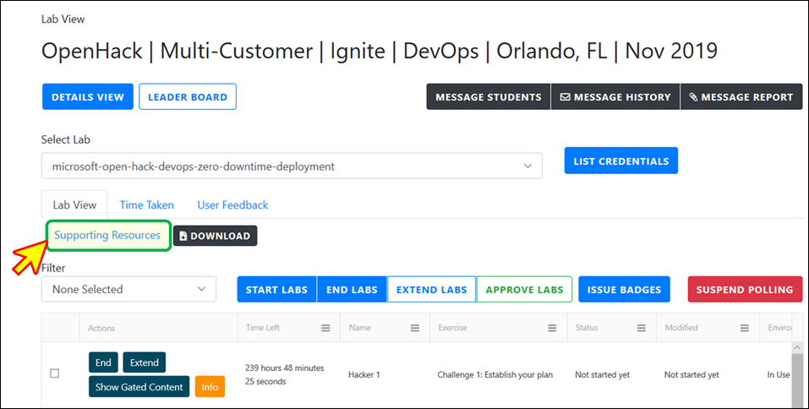
Working Session – Opsgility Portal
Coaches log-in at: https://cloudsandbox.skillmeup.com
Log into the Admin Portal with your alias@microsoft.com, Password123!
Explore the portal: user feedback, approve labs, and coach resources
Attendees OpenHack portal: aka.ms/ohportal
Log into attendee portal with your channel's hacker # and test the subscription
Refer to Coach Resources for final classroom login
Coach View

Slide 19
Working Session – Teams
Review the Team – confirm you have access & familiarize yourself with channels we will use for the OpenHack
Explore “Meet Now” feature – you will use this daily to meet with your team
Look at the different resources we’ve set up for guidance – General (participants), Coaches (private for coach team), and Team (with assignments & credentials)

Slide 20
Common Pitfalls

Slide 21

Do not skip to success criteria.
Notes:
Going straight to the success criteria establishes an anti-pattern as Openhack is ~challenge based, meaning you are working to solve the challenges. The success criteria is only there to help you determine when your team has done enough to go to the next challenge.
If you do find it easier to go through the success criteria first, ALWAYS go back to read the challenge in full.

Slide 22

Do not assume the team understands the challenge. Especially when working with beginners
Notes:
Cannot stress this enough. Make sure your team understands the challenge. Whether you read through the challenge as a team or allow individuals to read on their own… Make sure everyone on the team understands the problem. This is particularly important for beginners.

Slide 23


Do refer to coaches guide/cheat sheet.
Notes:
For challenge specific pitfalls, please refer to the guide/cheat sheet for coaches.

Slide 24

Do a design/plan for execution
Notes:
Once your team has a good understanding of the challenge, create a plan to execute. This could be creating tasks and/or workstreams.

Slide 25

Read the challenge as a team
Notes:
This has been effective in the past and helps to ensure understanding of the challenges.

Slide 26
Q&A

Slide 27


Get Involved
Attend an OpenHack @ aka.ms/OpenHackRegister
Coach OpenHack @ aka.ms/CoachOpenHack
Request OpenHack @ aka.ms/OpenHackRequest
Questions @ AskOpenHack@microsoft.com

Slide 28
Thank you Coaches!

Slide 29


Coaches bring your own Azure Subs to the OpenHack DryRun
As a Coach you will need to spin up your own Azure Subscription to use during the DryRun.
The bring your own subscription (BYOS) repository provides guidance on how to setup the Azure subscription for the DryRun.
Get the guidance at aka.ms/OpenHackBYOS

